Slide 1
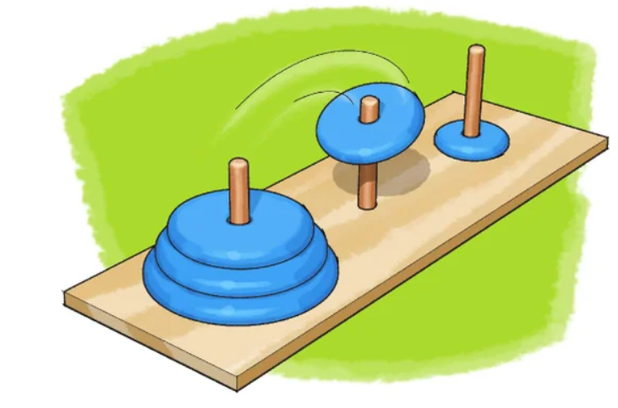
Interactive Tower of Hanoi v 1.4

Slide 2
History
There is a story about an Indian temple in Kashi Vishwanath which contains a large room with three time-worn posts in it, surrounded by 64 golden disks. Brahmin priests, acting out the command of an ancient prophecy, have been moving these disks in accordance with the immutable rules of Brahma since that time. The puzzle is therefore also known as the Tower of Brahma puzzle. According to the legend, when the last move of the puzzle is completed, the world will end.
If the legend were true, and if the priests were able to move disks at a rate of one per second, using the smallest number of moves it would take them 2⁶⁴ − 1 seconds or roughly 585 billion years to finish, which is about 42 times the current age of the Universe !

Slide 3
What is Tower of Hanoi ?
Is a mathematical game or puzzle It consists of three rods and a number of disks of different sizes, which can slide onto any rod. The puzzle starts with the disks in a neat stack in ascending order of size on one rod, the smallest at the top, thus making a conical shape.
To win the Game you should move the entire stack to another rod,
obeying the following simple rules:
Only one disk can be moved at a time.
Each move consists of taking the upper disk from one of the stacks and placing it on top of another stack or on an empty rod.
No larger disk may be placed on top of a smaller disk.

Slide 4


Slide 5
code development phases
Our code has four phases of development :
Version 1.1: functional programming without making class of the Solution , and implement the code using iterative
Version 1.2 : we add OOP by making class Solution which contains all the methods
Version 1.3 : we add Exception handling feature to our code
Version 1.4 : add queue structure to simplify the solution .

Slide 6
Code description
Our code is following object-oriented paradigm and its divided into two classes :
The first one is stack that implemented in linked nodes
The second one is the solution class which divided into 5 sections:
Section (1)
welcome message and let the user choose way of solution :
a) user solution b) Machine solution
Section(2):
Solution algorithms : this section include
checking if movement is legal or not to protect rules of the game.
protecting user from illegal movement , that leads the user to make fewer movements to help him win the game as optimal movement as he can.
Section(3):
prepare to show the user what happened in every step :
by converting the (3) Stacks into (3) Arrays and passing them to the drawing function.
Section(4):
Drawing algorithm to draw the towers in command line at the run time.

Slide 7
Code description cont.
To solve tower of Hanoi problem each tower is represented by a stack in linked implementation to make number of nodes according to user desire.
Every movement during solution journey must be displayed at the screen in one of two ways :
1) if number of disks less than or equal eight disks then the towers will be drawn at runtime in command line , we choose the max number = (8) to be friendly and comfortable to human eyes.
2) if disks larger than 8 disks then solution , we write every step by step for example : move from tower one to tower three

Slide 8
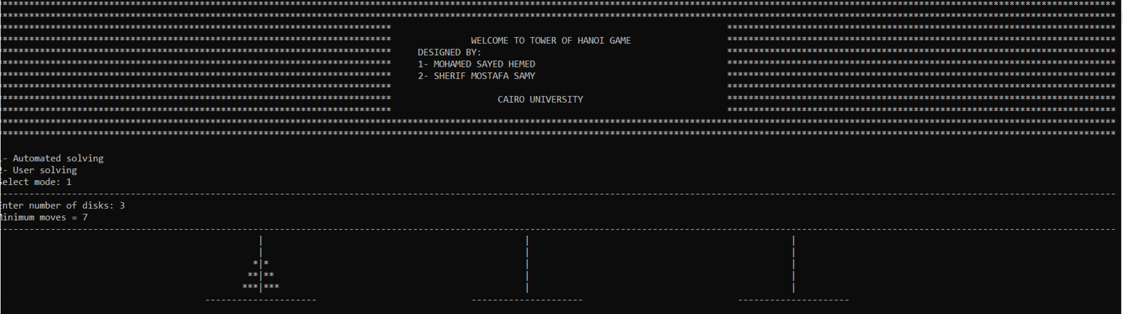
Solution Algorithm

Slide 9
Solution Algorithm
We try to solve this problem ourselves until we reach a pattern :
if we consider that three towes Are :
A B C
Then if number of disks is even :
Move from A ---> B in the direction which determined by the lesser top of (A,B)
Move from A ---> C in the direction which determined by the lesser top of (A,C)
Move from B ---> C in the direction which determined by the lesser top of (B,C)
Until the A,B become empty , and C have all disks stacked on each other.
But if number of disks is odd:
Move from A ---> C in the direction which determined by the lesser top of (A,B)
Move from A ---> B in the direction which determined by the lesser top of (A,C)
Move from B ---> C in the direction which determined by the lesser top of (B,C)

Slide 10
Code wiki
Method prototype | Return type | Arguments | description
initialization
void intro(); | void | No arguments | - Welcome message - initialization screen
void printLine(); | void
void startingScreen() | void
Solving algorithm
bool machineSolve(int &); | Boolean | Alias int | This method take alias int which equal number of disks and raise true flag whenever the solution done.
void userSolve(int&); | void | Alias int | This method take take alias int which equal number of disks , to enable the user to put disks into towers manually.
void fromAToB(StackLinked<int>&,StackLinked<int>&); void fromAToC(StackLinked<int>&,StackLinked<int>&); void fromBToC(StackLinked<int>&,StackLinked<int>&); | void | Two Alias objects of type Stack | These three methods take two stacks each of them represent one tower and decide the correct direction depends on the lesser top of them.
bool checkEmpty(StackLinked<int>&,StackLinked<int>&); | Boolean |  | This method take two stacks and check if all of them are empty ?
bool checkMove(StackLinked<int>&,StackLinked<int>&); | Boolean |  | This method take two stacks (A,B) Respectively and return true if the top of A is lesser than top of B.
Drawing algorithm
void drawingTowers(StackLinked<int>&,StackLinked<int>&,StackLinked<int>&,int); | void | Three Alias objects of type Stack | The main algorithm method that take the the three stacks to draw them , to do that we make a method in the stack implementation class convertToArr To convert each stack into array.
void ascendingOrder(int*&,int); | void | Alias pointer , int | This method take alias pointer and int , to order the array ascending. The incoming array is equivalent to each tower construction which indeed in descending order if we let it as it comes the towers base and peak will be take the place of each other.
void draw(int[],int[],int[],int); | void | Three Arrays of type int | This method take three arrays , and number of disks and draw them at the run time on the screen.
void drawPeaks(int&); | void | Alias int | Draw constant two peaks in each tower to make them user friendly.
void drawBottoms(); | void | No arguments | Draw constant base for each tower even if the tower is empty.
void displayStep(int,int); | void | Two int | Write every step in cmd

Slide 11
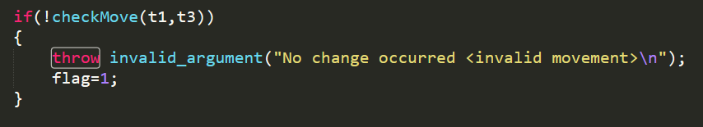
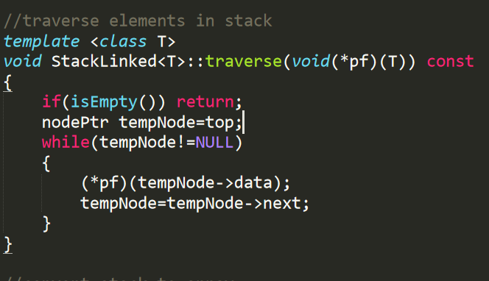
Abstraction and clean code
In this code we try to write a code to write a clean code as much as we can :
Readable : we make the code like a story
anyone can read whatever his mentality.
Easy to maintain : that lead us to improve
our code not once or twice , but we improve our code
four times and make four versions
of the game the last one is v1.4
Exception handling to protect the user from himself ,
to make him enjoy the game ,
and prevent any unexpected crashing of the game even
if the user IQ = 85 or less !
The beauty of abstraction appeared when
we pass (a pointer to function ) as argument to
a method called traverse in the stack implementation to
do any process the user want and traverse
the stack and do this process (read , … ) .

Slide 12
Drawing Algorithm
This algorithm to draw the towers at the same time in the run time :
we start from top to down and from left to right.
First we have three arrays : towerOne, towerTwo , towerThree each of them represent one tower
So we divided the screen into three towers and 4 spaces :
bigSpace= ( screenWidth - ( 3 * 8 ) ) / 4;
diffSpaceOne = bigSpace - towerOne[index];
diffSpaceTwo = bigSpace - (towerOne[index] + towerTwo[index]);
diffSpaceThree = bigSpace - (towerTwo[index] + towerThree[index]);
diffSpaceFour = bigSpace - towerThree[index];
So to make the view user friendly and the spaces are symmetric between
each tower we imagine that each
line is an equation so
Let bigSpace = B , diffSpaceOne = s1, diffSpaceTwo = s2, diffSpaceThree = s3, diffSpaceFour=s4
towerOne = t1 , towerTwo = t2 , towerThree = t3
So line Equation = B s1 t1[i] “|” t1[i] B s2 t2[i] “|” t2[i] B s3 t3[i] “|” t3[i] B s4
We do for loops goes from zero till the value of each variable.
At the top of each tower we draw a constant two peaks , and under every tower we draw a constant base.

Slide 13
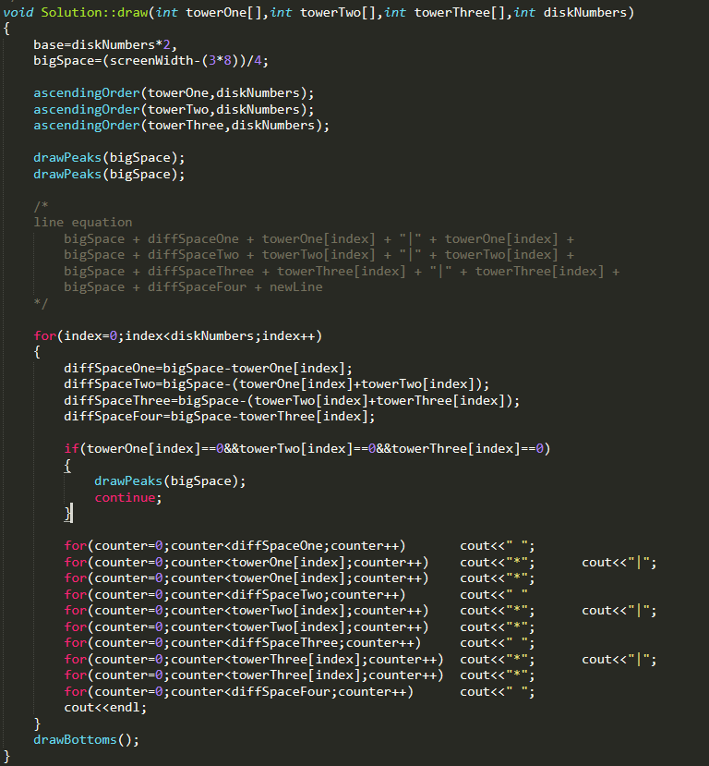
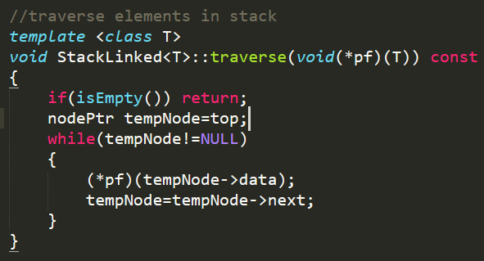
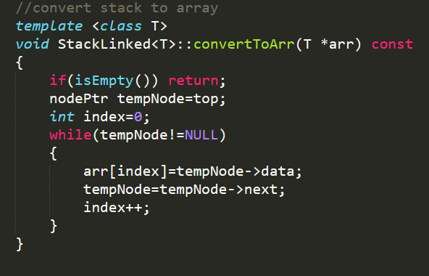
Best lines of the code

Slide 14
